Slide 1




Detecting Subsequence Anomalies in Time Series
ECML/PKDD 2024 Tutorial
An Introduction to Machine Learning from Time Series
Sebastian Schmidl
sebastian.schmidl@hpi.de
Phillip Wenig
phillip.wenig@hpi.de
Thorsten Papenbrock
papenbrock@uni-marburg.de
Hasso Plattner Institute (HPI)
University of Potsdam, Germany
Hasso Plattner Institute (HPI)
University of Potsdam, Germany
Philllipps-University of Marburg
Germany

Slide 2
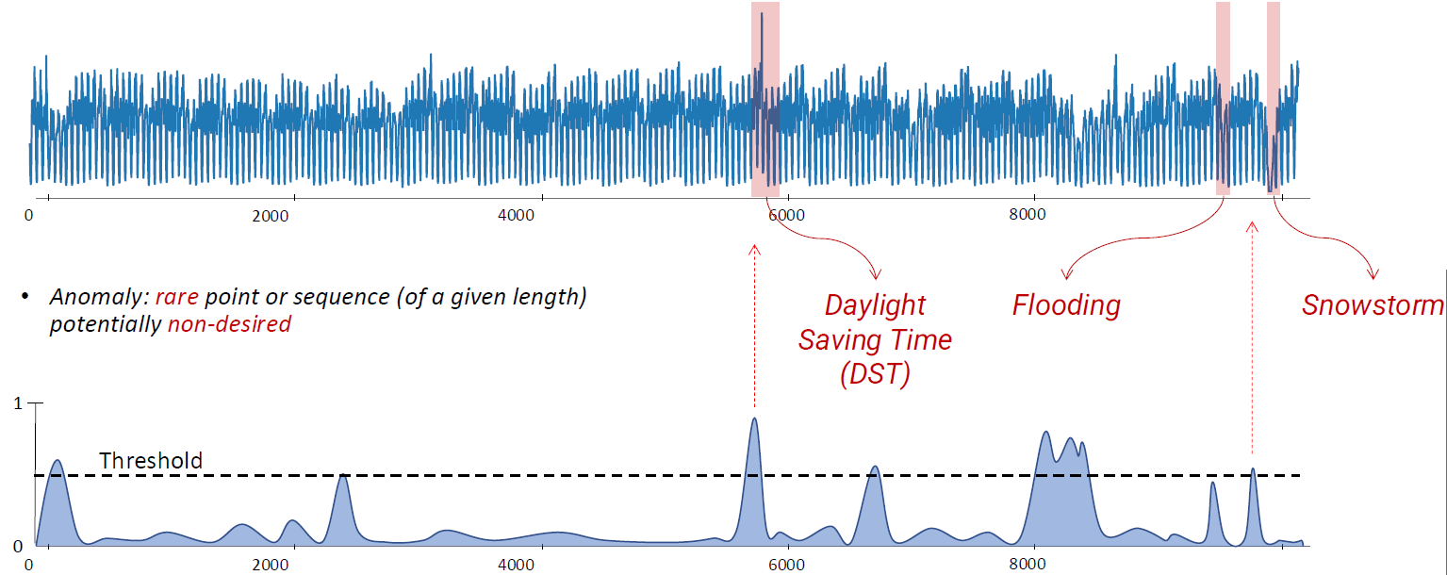
Introduction
„
An anomaly is a point or a sequence of points that deviate w.r.t. some measure or model from the regular patterns of the time series.
“
For this tutorial:
A potentially undesired rare point or rare sequence of points of a given length.
Normal: Low Score
Anomalous: High Score
Image from Boniol et al. Time-Series Anomaly Detection: Overview and New Trends. VLDB 2024

Slide 3
Outline
Types of Anomalies
Anomaly Detection Methods
Example Methods
Distance-based: Matrix Profile
Tree-based: Isolation Forest
Forecasting-based: LSTM-AD
Benchmarks & Datasets
Performance Comparison
Outlook

Slide 4





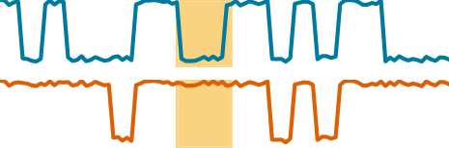
Types of Anomalies
Anomaly Types
Point
Subsequence
Correlation
Global
Contextual
Global
Contextual
Global
Contextual
Phillip Wenig, Sebastian Schmidl, Thorsten Papenbrock: Anomaly Detectors for Multivariate Time Series: The Proof of the Pudding is in the Eating. Proceedings of the International Conference on Data Engineering Workshops (ICDEW), 2024. DOI:10.1109/ICDEW61823.2024.00018

Slide 5
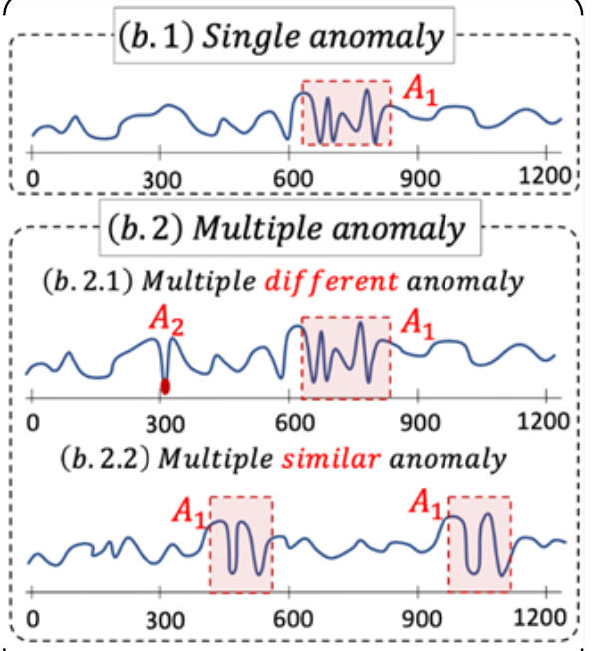
Types of Anomalies
Image from Boniol et al. Time-Series Anomaly Detection: Overview and New Trends. VLDB 2024

Slide 6
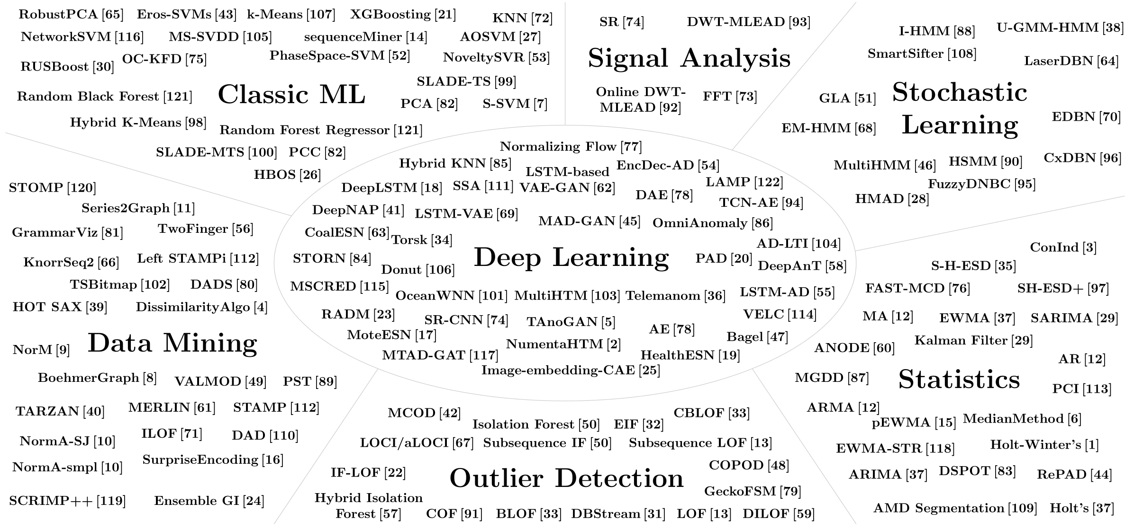
Anomaly Detection Methods – by Research Domains
Sebastian Schmidl, Phillip Wenig, Thorsten Papenbrock: Anomaly Detection in Time Series: A Comprehensive Evaluation. PVLDB 9:(15), 2022. DOI:10.14778/3538598.3538602

Slide 7
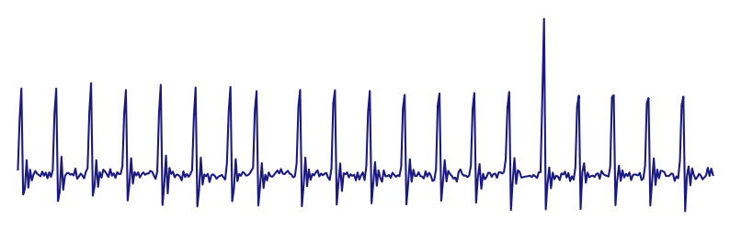

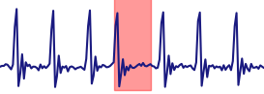
Anomaly Detection Methods – by Learning Type
Training
Testing
Unsupervised
(Type I [a])
Supervised
(Type II [a])
Semi-Supervised
(Type II [a])
[a] Victoria J. Hodge and Jim Austin. 2004. A Survey of Outlier Detection Methodologies. Artificial Intelligence Review, 22, 2, 85–126. doi: 10.1007/s10462-004-4304-y

Slide 8
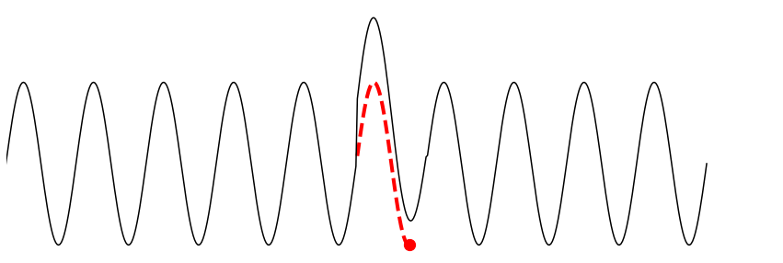

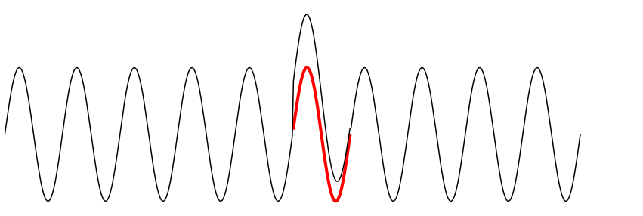

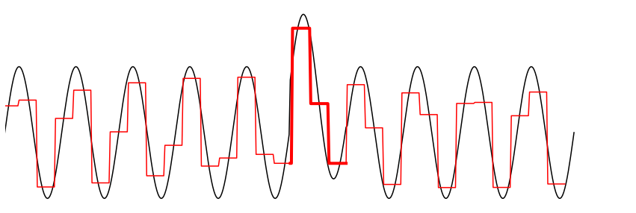

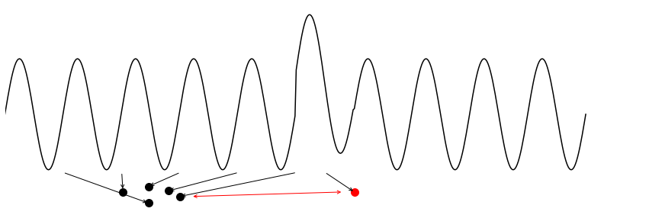



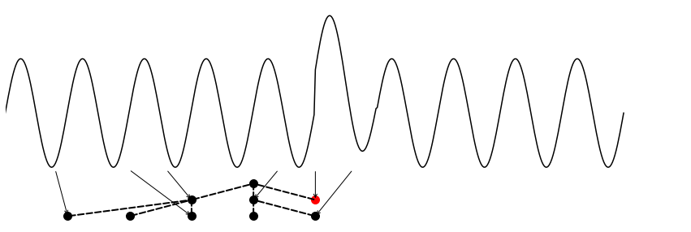

Anomaly Detection Methods – by Family
Forecasting
Reconstruction
Encoding
Distance
Distribution
Isolation Tree
ARIMA, DeepAnT, DeepNAP, HealthESN, LSTM-AD, MedianMethod, MTAD-GAT, NumentaHTM, NoveltySVR, OceanWNN, RBForest, RForest, SARIMA, Telemanom, Torsk, Triple ES, XGBoosting
AE, Bagel, DAE, Donut, EncDec-AD, FFT, IE-CAE, LSTM-VAE, MSCRED, OmniAnomaly, PCI, PCC, RobustPCA, SR, SR-CNN, TAnoGan
Ensemble GI, GrammarViz, LaserDBN, MultiHMM, PST, Series2Graph, TARZAN, TSBitmap
CBLOF, COF, DBStream, HOT SAX, Hybrid KNN, k-Means, KNN, LOF, NormA-SJ, PS-SVM, SAND, SSA, STAMP, STOMP, Sub-LOF, VALMOD, Left STAMPi
COPOD, DWT-MLEAD, Fast-MCD, HBOS, NF, S-H-ESD, DSPOT, Sub-Fast-MCD
EIF, HIF, IF-LOF, iForest, Sub-IF

Slide 9
Distance-based: MatrixProfile
Parameter: window size m
Anomaly score of each subsequence = distance to the nearest neighbor subsequence
Z-norm Euclidean distance
Excludes self-matches
Unsupervised
Many variations:
Streaming: STAMPi, DAMP
Anytime: STAMP, STOMP
For reoccurring anomalies: left-STAMP
For multivariate time series: mSTAMP
Chin-Chia Michael Yeh, Yan Zhu, Liudmila Ulanova, Nurjahan Begum, Yifei Ding, Hoang Anh Dau, Diego Furtado Silva, Abdullah Mueen, and Eamonn J. Keogh. 2016. Matrix Prole I: All Pairs Similarity Joins for Time Series. In ICDM.

Slide 10
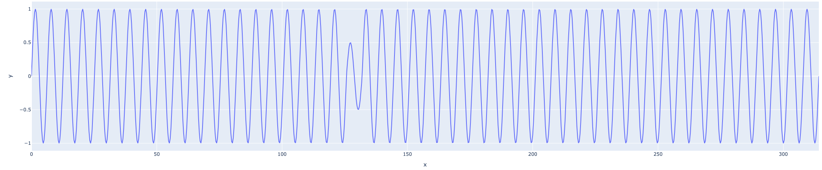
Distance-based: MatrixProfile
Chin-Chia Michael Yeh, Yan Zhu, Liudmila Ulanova, Nurjahan Begum, Yifei Ding, Hoang Anh Dau, Diego Furtado Silva, Abdullah Mueen, and Eamonn J. Keogh. 2016. Matrix Prole I: All Pairs Similarity Joins for Time Series. In ICDM.

Slide 11
Distance-based: MatrixProfile
…
Subsequence of length m
Chin-Chia Michael Yeh, Yan Zhu, Liudmila Ulanova, Nurjahan Begum, Yifei Ding, Hoang Anh Dau, Diego Furtado Silva, Abdullah Mueen, and Eamonn J. Keogh. 2016. Matrix Prole I: All Pairs Similarity Joins for Time Series. In ICDM.

Slide 12
Distance-based: MatrixProfile
…
closest neighbor
Chin-Chia Michael Yeh, Yan Zhu, Liudmila Ulanova, Nurjahan Begum, Yifei Ding, Hoang Anh Dau, Diego Furtado Silva, Abdullah Mueen, and Eamonn J. Keogh. 2016. Matrix Prole I: All Pairs Similarity Joins for Time Series. In ICDM.

Slide 13
Distance-based: MatrixProfile
…
closest neighbor
Distance to closest neighbor
Chin-Chia Michael Yeh, Yan Zhu, Liudmila Ulanova, Nurjahan Begum, Yifei Ding, Hoang Anh Dau, Diego Furtado Silva, Abdullah Mueen, and Eamonn J. Keogh. 2016. Matrix Prole I: All Pairs Similarity Joins for Time Series. In ICDM.

Slide 14
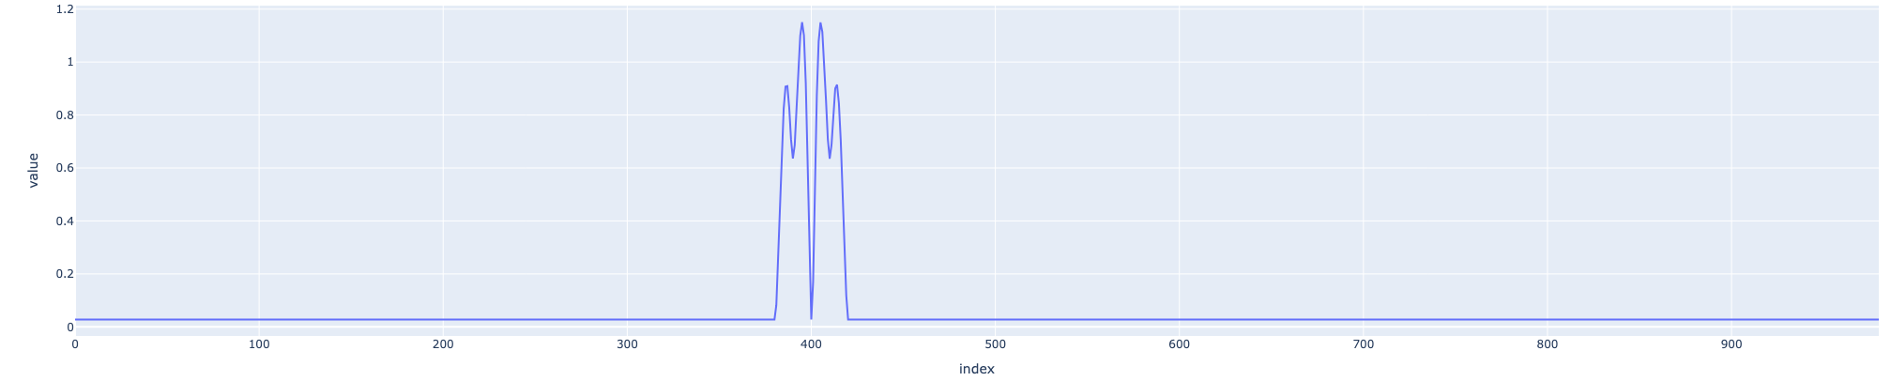
Distance-based: MatrixProfile
…
closest neighbor
Chin-Chia Michael Yeh, Yan Zhu, Liudmila Ulanova, Nurjahan Begum, Yifei Ding, Hoang Anh Dau, Diego Furtado Silva, Abdullah Mueen, and Eamonn J. Keogh. 2016. Matrix Prole I: All Pairs Similarity Joins for Time Series. In ICDM.

Slide 15

Tree-based: Isolation Forest
Partitions points or subsequences randomly in trees
Tries to isolate individual samples
Anomaly score = average reciprocal path between the roots and the sample
unsupervised
Fei Tony Liu, Kai Ming Ting, and Zhi-Hua Zhou. 2008. Isolation Forest. In Proceedings of the International Conference on Data Mining (ICDM), 413–422. doi: 10.1109/ICDM.2008.17.

Slide 16
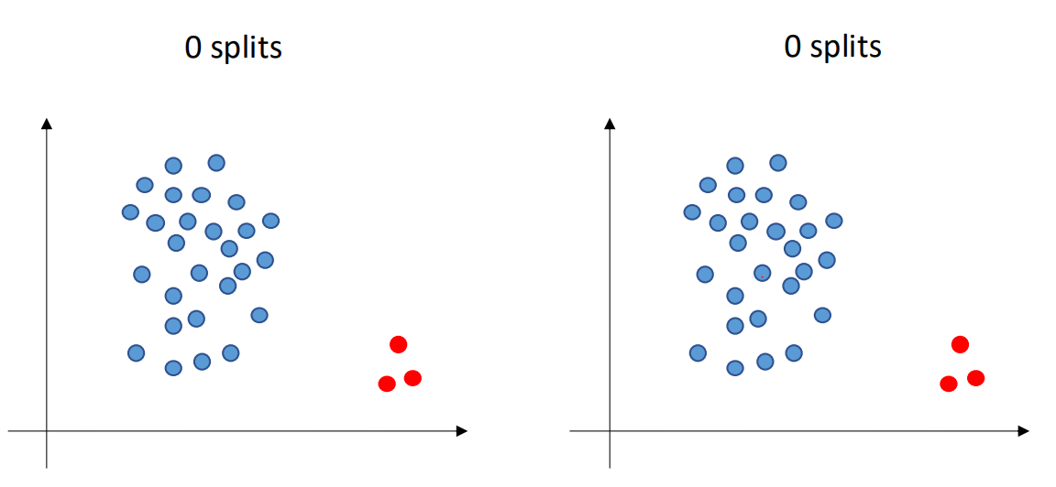
Tree-based: Isolation Forest
Fei Tony Liu, Kai Ming Ting, and Zhi-Hua Zhou. 2008. Isolation Forest. In Proceedings of the International Conference on Data Mining (ICDM), 413–422. doi: 10.1109/ICDM.2008.17.
Screenshot from Boniol et al. Time-Series Anomaly Detection: Overview and New Trends. VLDB 2024

Slide 17
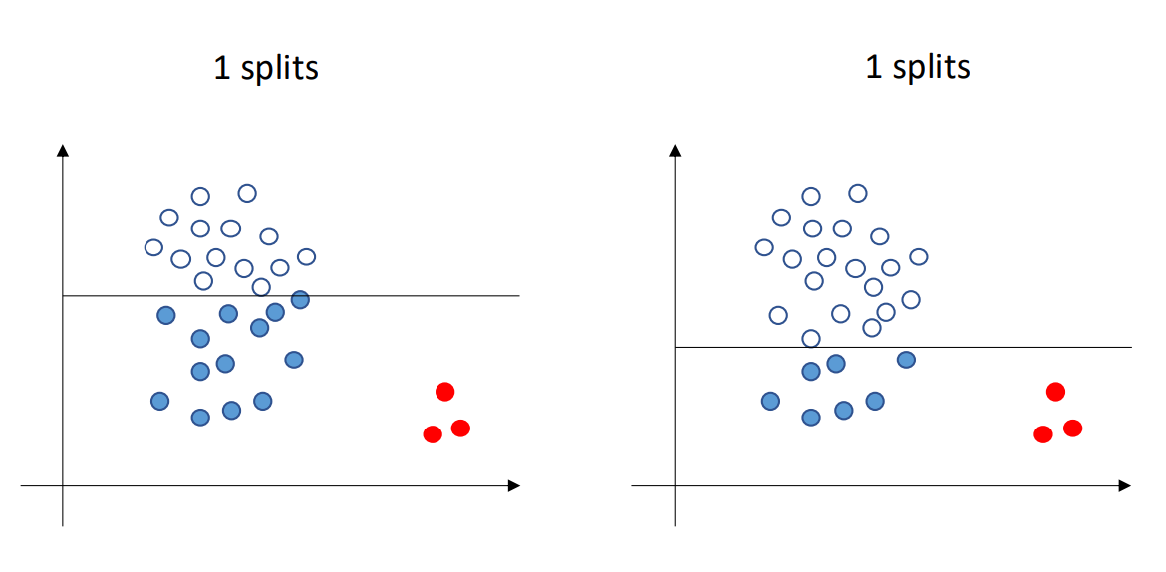
Tree-based: Isolation Forest
Fei Tony Liu, Kai Ming Ting, and Zhi-Hua Zhou. 2008. Isolation Forest. In Proceedings of the International Conference on Data Mining (ICDM), 413–422. doi: 10.1109/ICDM.2008.17.
Screenshot from Boniol et al. Time-Series Anomaly Detection: Overview and New Trends. VLDB 2024

Slide 18
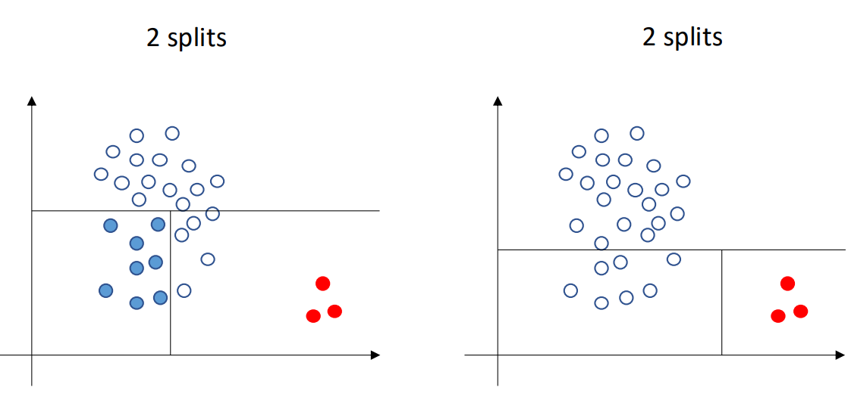
Tree-based: Isolation Forest
Fei Tony Liu, Kai Ming Ting, and Zhi-Hua Zhou. 2008. Isolation Forest. In Proceedings of the International Conference on Data Mining (ICDM), 413–422. doi: 10.1109/ICDM.2008.17.
Screenshot from Boniol et al. Time-Series Anomaly Detection: Overview and New Trends. VLDB 2024

Slide 19
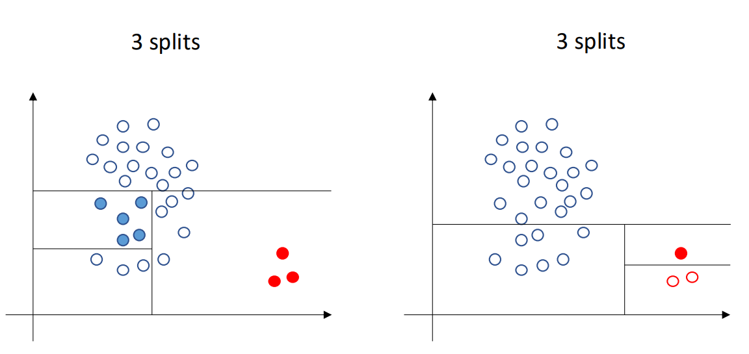
Tree-based: Isolation Forest
Fei Tony Liu, Kai Ming Ting, and Zhi-Hua Zhou. 2008. Isolation Forest. In Proceedings of the International Conference on Data Mining (ICDM), 413–422. doi: 10.1109/ICDM.2008.17.
Screenshot from Boniol et al. Time-Series Anomaly Detection: Overview and New Trends. VLDB 2024

Slide 20
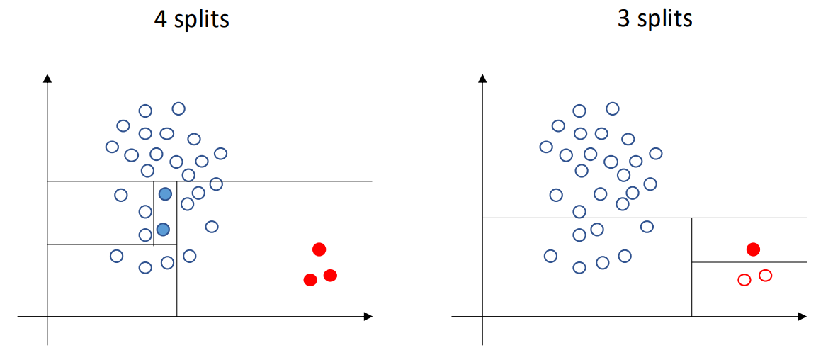
Tree-based: Isolation Forest
Fei Tony Liu, Kai Ming Ting, and Zhi-Hua Zhou. 2008. Isolation Forest. In Proceedings of the International Conference on Data Mining (ICDM), 413–422. doi: 10.1109/ICDM.2008.17.
Screenshot from Boniol et al. Time-Series Anomaly Detection: Overview and New Trends. VLDB 2024

Slide 21
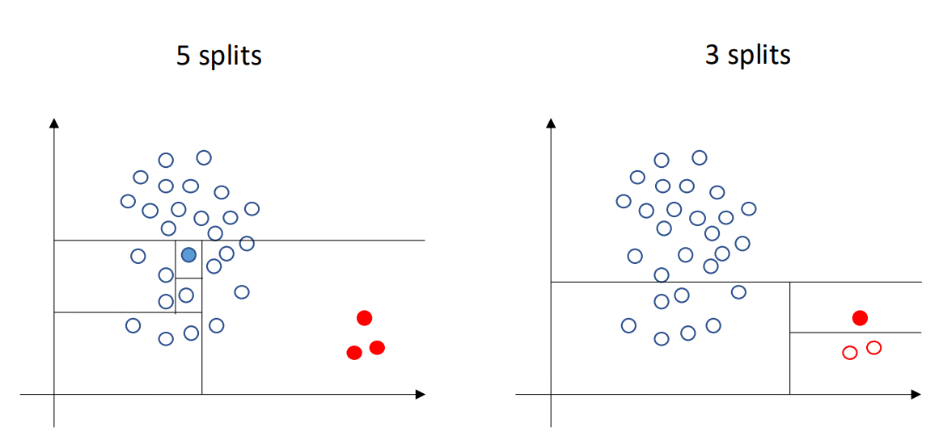
Tree-based: Isolation Forest
Fei Tony Liu, Kai Ming Ting, and Zhi-Hua Zhou. 2008. Isolation Forest. In Proceedings of the International Conference on Data Mining (ICDM), 413–422. doi: 10.1109/ICDM.2008.17.
Screenshot from Boniol et al. Time-Series Anomaly Detection: Overview and New Trends. VLDB 2024

Slide 22
Forecasting-based: LSTM-AD

Slide 23

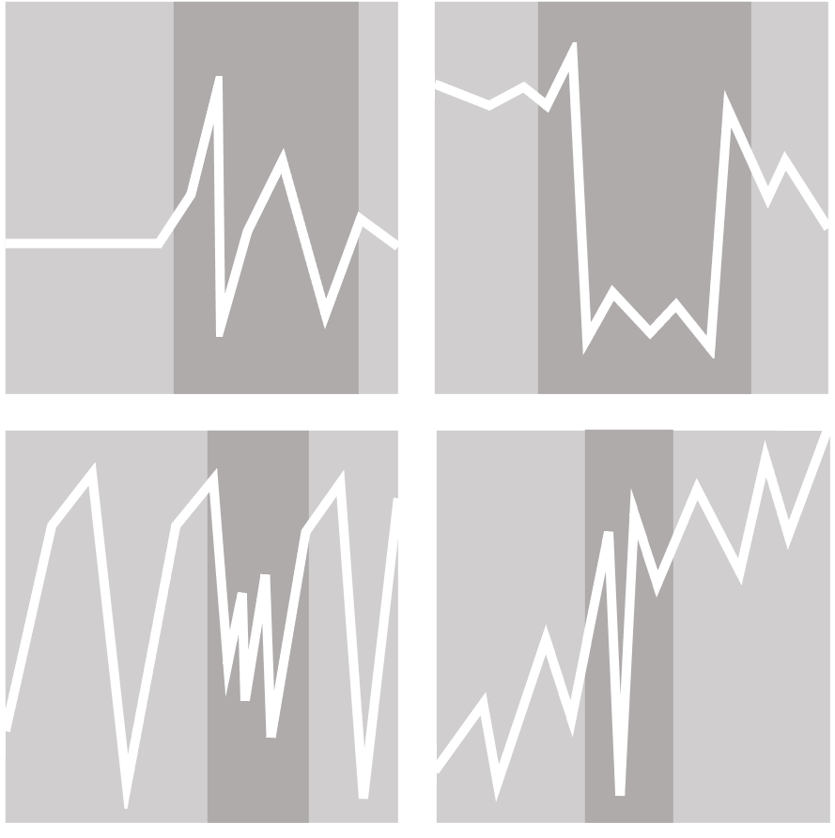


Benchmarks & Datasets
NAB
58 time series
Real-world and synthetic
Streaming
Own scoring mechanism
Various domains
HEX/UCR
250 time series
Manually checked labels
Only 1 annotated anomaly per time series
Various domains
TSB-UAD
2.000 time series
No filtering
Proposes data transformations to introduce new anomalies in existing time series
Includes time series generated from classification datasets
976 time series
Only time series with contamination <0.1, at least one method above 0.8 ROC-AUC and at least one anomaly
Synthetic time series generator GutenTAG for parameter tuning

Slide 24
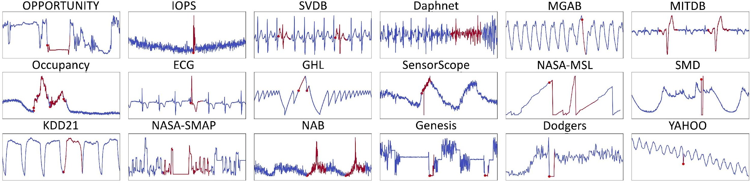
Benchmarks & Datasets
Real-world dataset examples
Image from TSB-UAD repository.

Slide 25
Datasets repositories
HEX/UCR
NASA
TSB-UAD
…

Slide 26
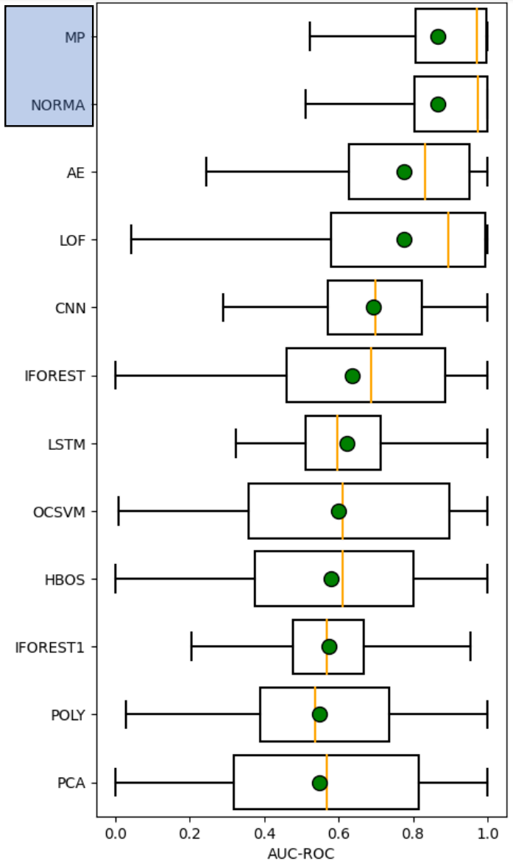
HEX/UCR Insights
Distance methods have better accuracy than forecasting or reconstruction methods
Renjie Wu and Eamonn J. Keogh. 2020. Current Time Series Anomaly Detection Benchmarks are Flawed and are Creating the Illusion of Progress. IEEE Transactions on Knwoledge & Data Engineering, vol. 35, no. 04, 2023.
Image from Boniol et al. Time-Series Anomaly Detection: Overview and New Trends. VLDB 2024

Slide 27
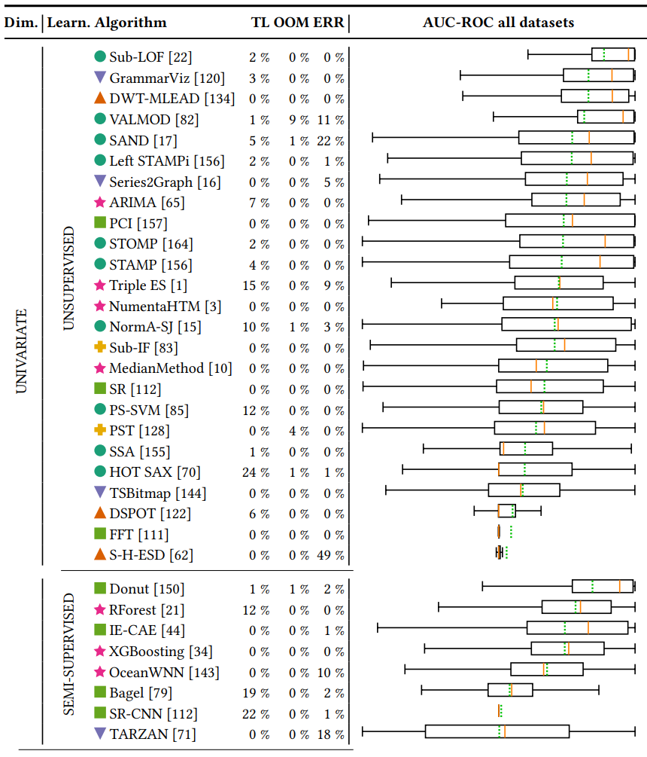
TimeEval Insights
Distance methods have better accuracy than forecasting or reconstruction methods
Semi-supervised are NOT outperforming unsupervised
There is no overall winner!
Sebastian Schmidl, Phillip Wenig, Thorsten Papenbrock: Anomaly Detection in Time Series: A Comprehensive Evaluation. PVLDB 9:(15), 2022. DOI:10.14778/3538598.3538602

Slide 28
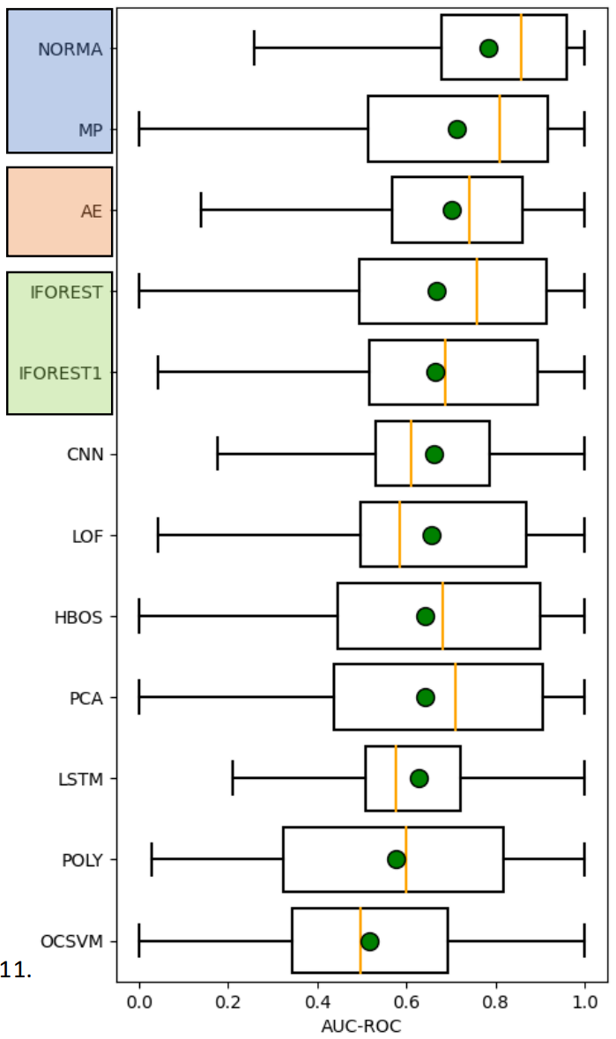
TSB-UAD Insights
Distance methods have better accuracy than forecasting methods
Isolation Forest is very competitive
John Paparrizos, Yuhao Kang, Paul Boniol, Ruey S. Tsay, Themis Palpanas, and Michael J. Franklin. 2022. TSB-UAD: an end-to-end benchmark suite for univariate time-series anomaly detection. Proc. VLDB Endow. 15, 8 (2022).
Image from Boniol et al. Time-Series Anomaly Detection: Overview and New Trends. VLDB 2024

Slide 29
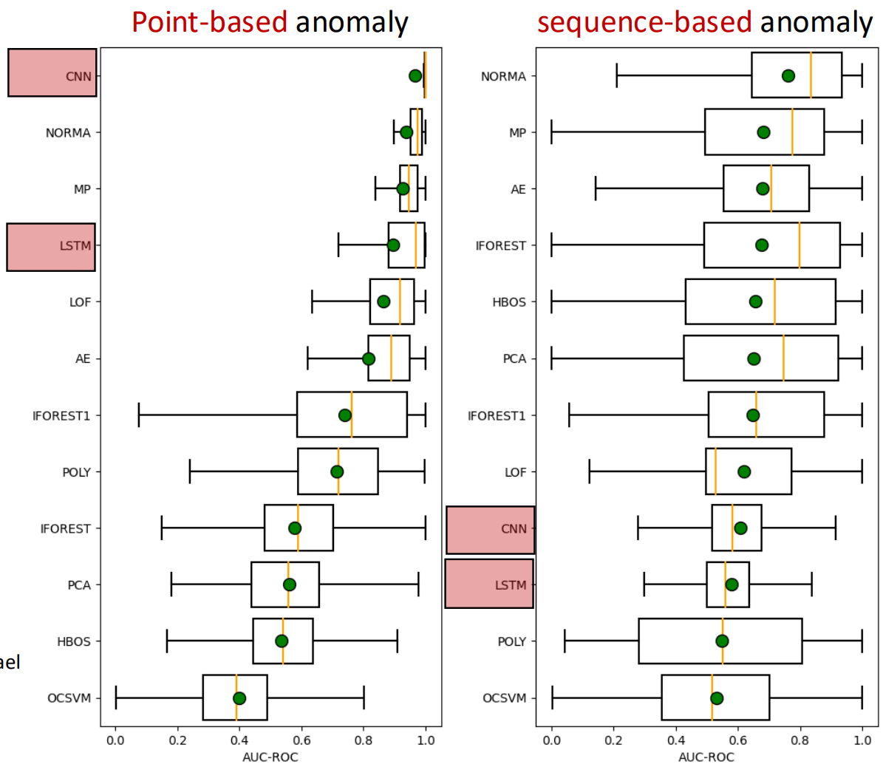
TSB-UAD Insights
Distance methods have better accuracy than forecasting methods
Isolation Forest is very competitive
Forecasting methods are good in detecting point anomalies, but bad in detecting subsequence anomalies
There is no overall winner!
John Paparrizos, Yuhao Kang, Paul Boniol, Ruey S. Tsay, Themis Palpanas, and Michael J. Franklin. 2022. TSB-UAD: an end-to-end benchmark suite for univariate time-series anomaly detection. Proc. VLDB Endow. 15, 8 (2022).
Image from Boniol et al. Time-Series Anomaly Detection: Overview and New Trends. VLDB 2024

Slide 30
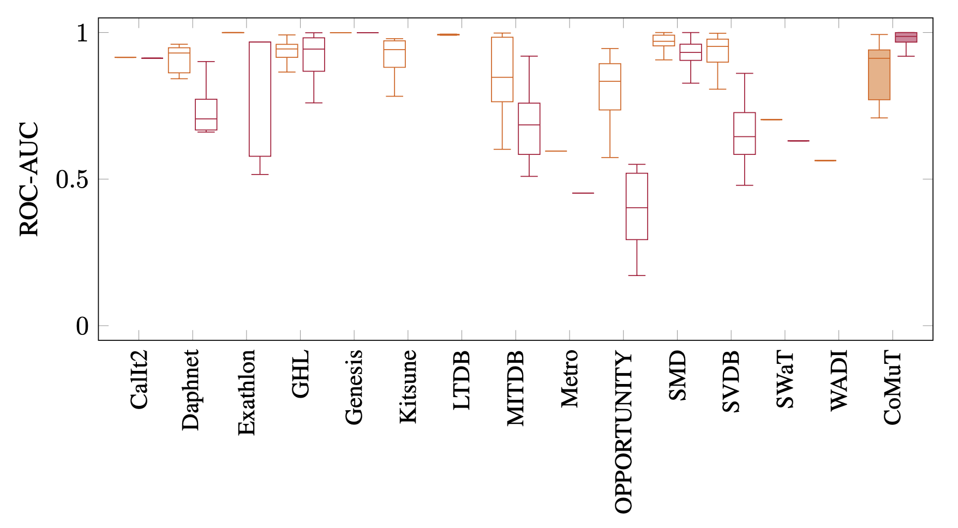
Multivariate Benchmarks are too easy
Max ROC-AUC per time series over all algorithms
Univariate
Multivariate
Phillip Wenig, Sebastian Schmidl, Thorsten Papenbrock: Anomaly Detectors for Multivariate Time Series: The Proof of the Pudding is in the Eating. Proceedings of the International Conference on Data Engineering Workshops (ICDEW), 2024. DOI:10.1109/ICDEW61823.2024.00018

Slide 31
Multivariate Benchmarks are too easy
Max ROC-AUC per time series over all algorithms
Univariate
Multivariate
Phillip Wenig, Sebastian Schmidl, Thorsten Papenbrock: Anomaly Detectors for Multivariate Time Series: The Proof of the Pudding is in the Eating. Proceedings of the International Conference on Data Engineering Workshops (ICDEW), 2024. DOI:10.1109/ICDEW61823.2024.00018

Slide 32
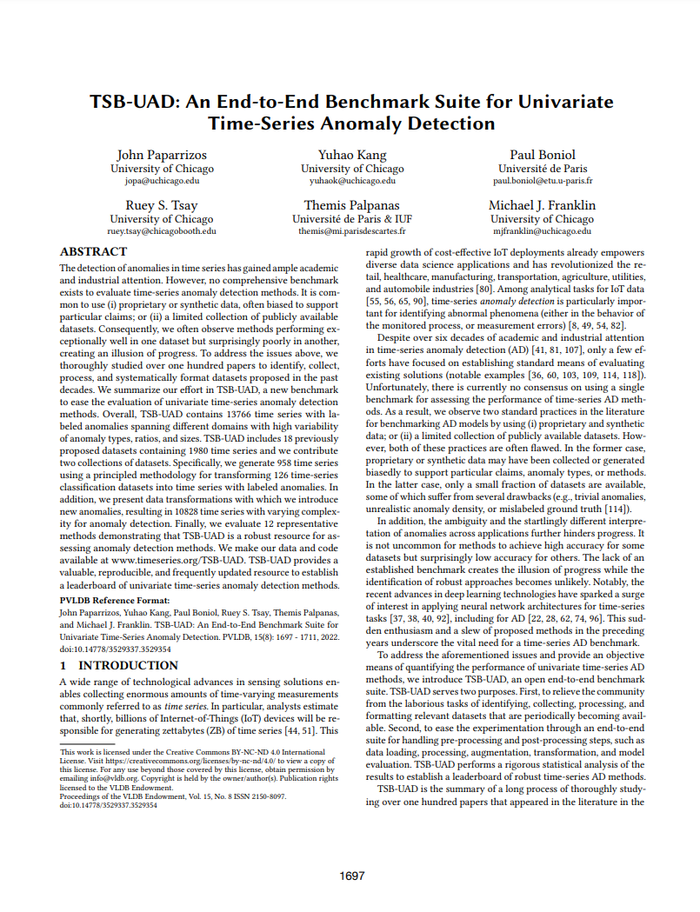
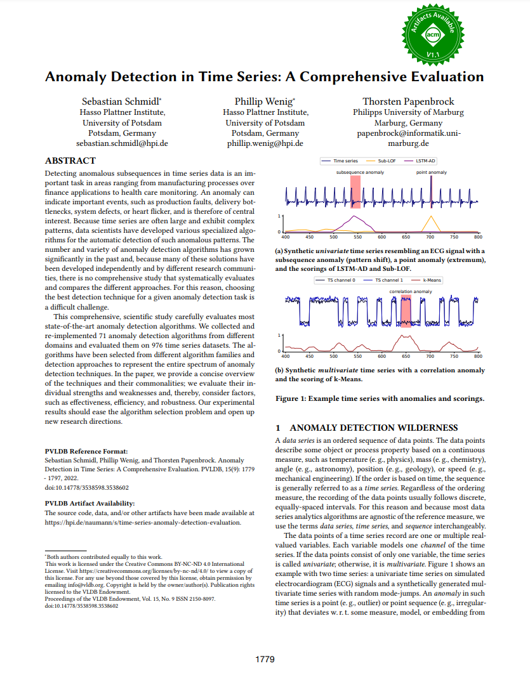
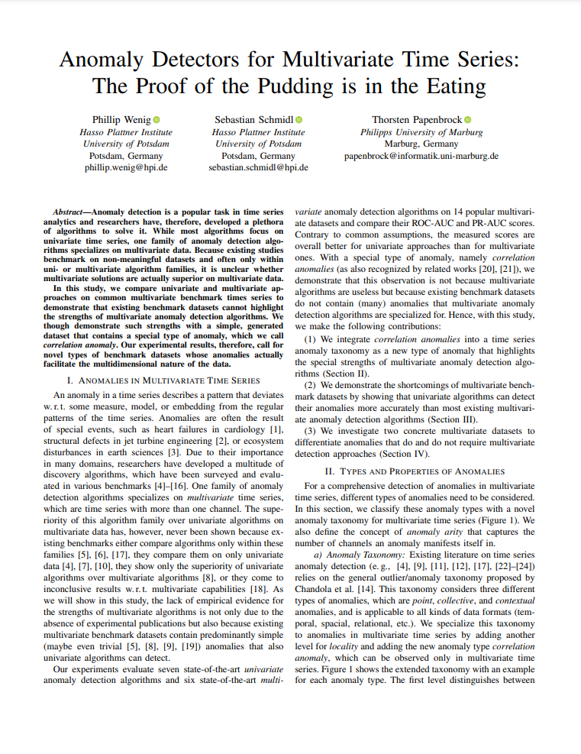
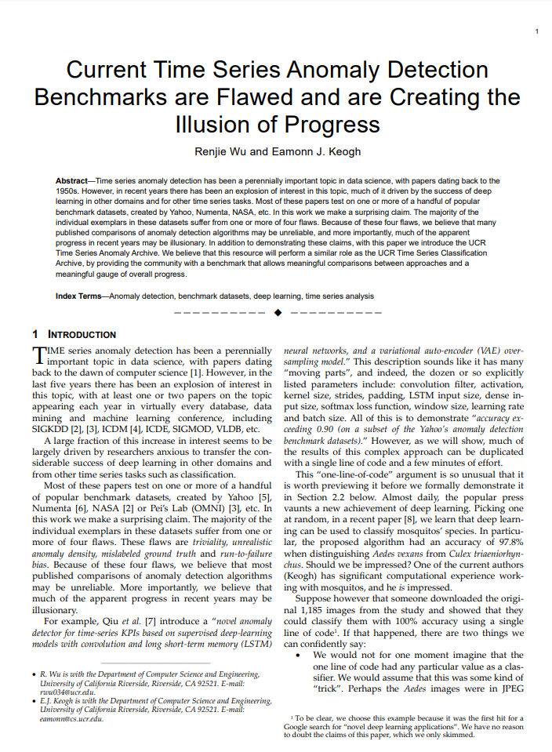
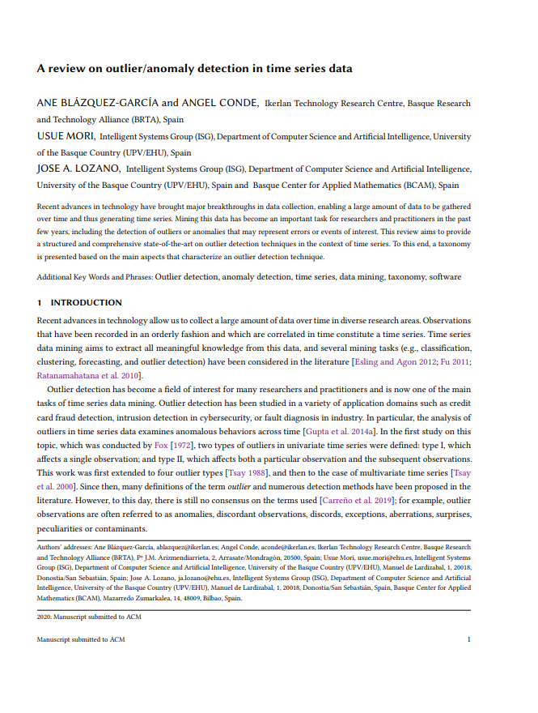
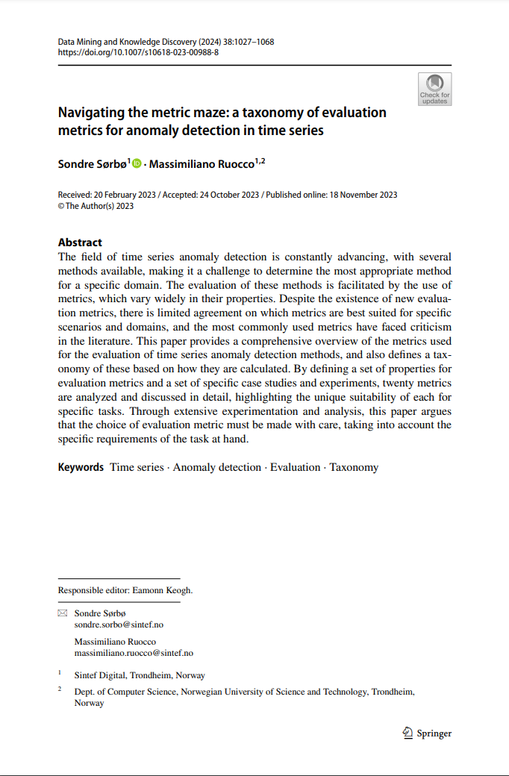
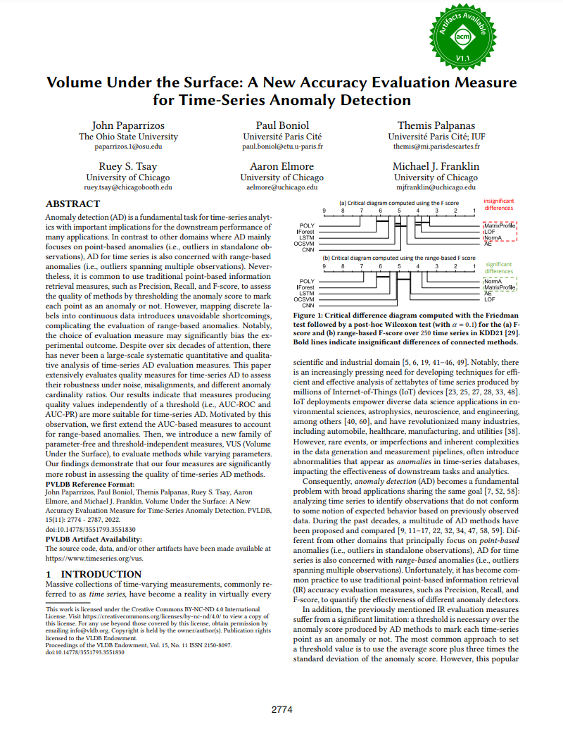
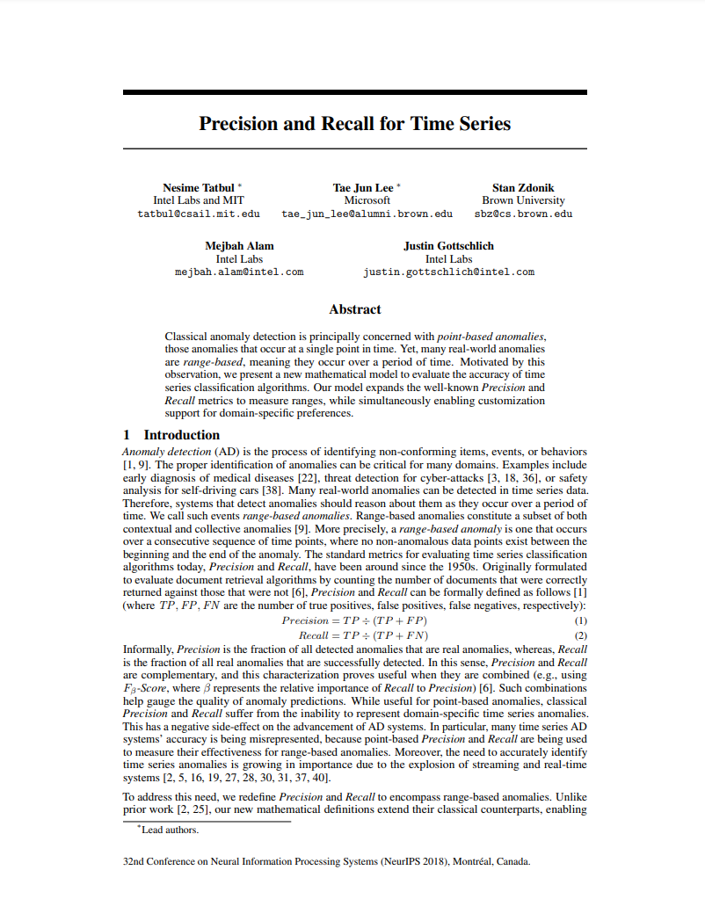
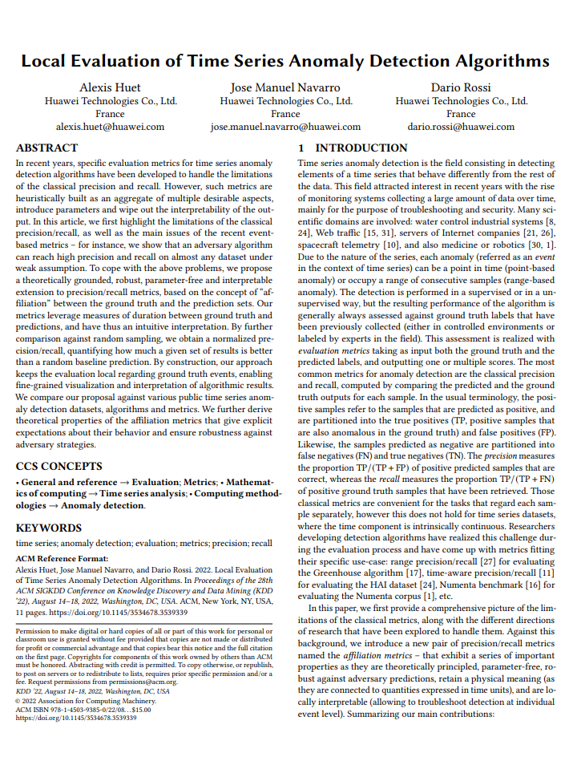
Recommended Reads
Paparrizos et al. PVLDB (2022) https://doi.org/10.1109/ICDEW61823.2024.00018
Schmidl et al. PVLDB (2022)
https://doi.org/10.14778/3538598.3538602
Wenig et al. ICDEW (2024) https://doi.org/10.1109/ICDEW61823.2024.00018
Sørbø et al. Data Min Knowl Disc (2024)
https://doi.org/10.1007/s10618-023-00988-8
Blázquez-García et al. ACM Comput Surv (2021) https://doi.org/10.1145/3444690
Wu et al. TKDE (2023) https://doi.org/10.1109/TKDE.2021.3112126
Paparrizos et al. PVLDB (2022) https://doi.org/10.14778/3551793.3551830
Tatbul et al. NeurIPS (2018) https://doi.org/10.1145/3444690
Huet et al. KDD (2022) https://doi.org/10.1145/3534678.3539339

Slide 33
Example code
M.Middlehurst@uea.ac.uk
See part6_anomaly_detection.ipynb

Slide 34
Outlook
For Research
No one-size-fits-all solution, but already 100s of methods
Research into automatic method selection and ensembling methods (copy example from Paul)
More and better benchmarks
Existing benchmark datasets have flaws
Existing evaluations are biased
LLMs / TS Foundation Models ?
Explainability / Precursor Detection / Anomaly Classification
In Aeon
Add more detectors (especially deep learning)
Add missing metrics

